Slide 1
Smart Multilingual Chatbot-based Digital Assistant for PGRKAM Portal
CSE7101- Capstone Project
Review-1
Batch Number: CIT_49
Under the Supervision of,
Dr./Mr./Ms./Prof. Ms.Chandhana C , Ms.Bhavya B
Professor / Associate Professor / Assistant Professor
School of Computer Science and Engineering
Presidency University
Roll Number | Student Name
20221CIT0002 20221CIT0021 20221CIT0020 | SUPREETH K D PRAWJAL DENZIL HEVIN PATIL
Name of the Program: Capstone Project
Name of the HoD: Dr. Anandaraj S.P
Name of the Program Project Coordinator: Dr. Sharmasth Vali
Name of the School Project Coordinators: Dr. Sampath A K , Dr. Geetha A

Slide 2
Problem Statement Number: PSCS_17
Organization: Government of Punjab
Category (Hardware / Software / Both) : Software
Problem Description: The PGRKAM portal offers multiple modules for jobs, skill development, and counseling, but users face difficulty navigating and finding relevant services. A smart LLM-powered chatbot is required to provide multilingual text/voice support, personalized recommendations, and easier access to information, reducing time and effort for job seekers.

Slide 3
Content
Problem Statement
Objectives
Background and Related work for title Selection
Analysis of Problem Statement
Innovation or Novel Contributions
Git-hub Link
Timeline of the Project
References

Slide 4
Content (continuation)..
Problem Statement
The Employment Department, Government of Punjab runs the PGRKAM portal & mobile app to provide job and skill-related services.
The platform has multiple modules: jobs (private & govt.), self-employment, foreign jobs, counseling, guidance, armed forces induction, job melas, etc.
Currently, no hand-holding mechanism exists → users must navigate across modules manually.
Lack of personalized assistance leads to poor user experience and longer query resolution time.
Objectives
Develop a LLM-based smart chatbot (using GPT-3/ChatGPT-like transformer models).
Provide multilingual text & voice query support (Punjabi, Hindi, English).

Slide 5
Content (continuation)..
Enable personalized recommendations based on candidate history and preferences.
Reduce search/navigation time on PGRKAM portal.
Background and Related work for title Selection
AI-based assistants (Google Assistant, Alexa) show success in voice interaction but are not domain-specific.
Gap: No existing AI-powered multilingual assistant integrated with PGRKAM-like portals for job seekers in India.
Opportunity: Build a smart automation system with LLM-driven chatbot for employment services.
Analysis of Problem Statement
User s’ problem: Difficulty in navigating and finding relevant services on PGRKAM.
Stakeholders: Job seekers, employers, skill development centers, counseling agencies.
Impact: Increases time, effort, and confusion for users.
Proposed solution: A chatbot that directly guides users, answers queries, and recommends relevant jobs/courses.

Slide 6
Content (continuation)..
Innovation
LLM-powered chatbot (GPT-like transformers) for real-time query resolution.
Multilingual voice & text support (Punjabi/Hindi/English).
Smart personalization using candidate history.
Accessibility-focused design (screen reading + speech-to-text).
Recommendation engine integrated with PGRKAM job database.
Git-hub Link
https://github.com/supreeth1311/pgrkam-smart-assistant

Slide 7
Content (continuation)..
Technology Stack Components:
Frontend: ReactJS / Streamlit (chat interface)
Backend: Python (FastAPI/Flask/Google API)
NLP/AI Models: Hugging Face Transformers, GPT-3 API / LLaMA 2
Database: PostgreSQL / MongoDB
Speech Modules: Google Speech-to-Text, gTTS for Text-to-Speech
Hosting: Cloud (AWS/Streamlit Cloud)
Version Control: GitHub

Slide 8
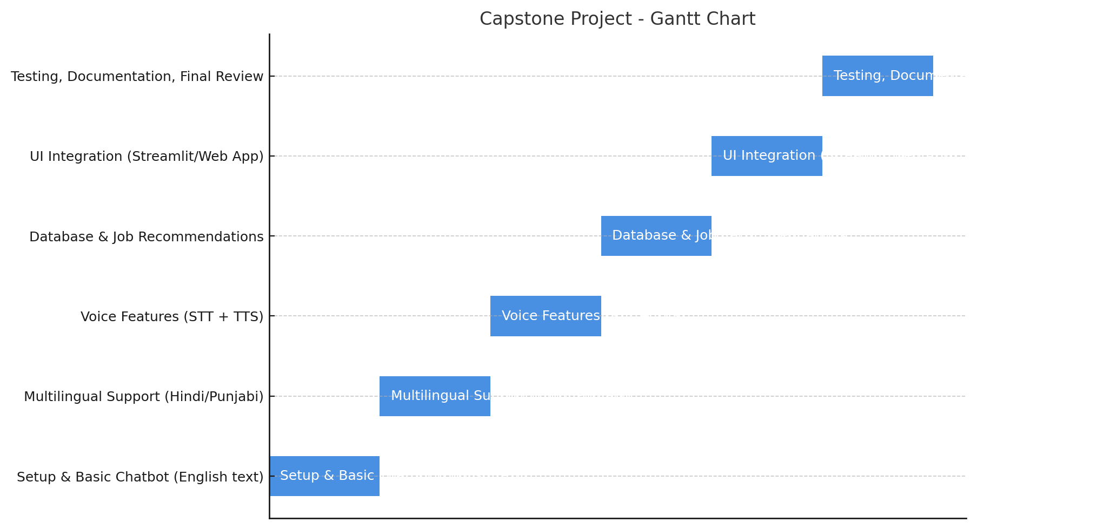
Timeline of the Project (Gantt Chart)

Slide 9
References (IEEE Paper format)
[1] Government of Punjab, “Punjab Ghar Ghar Rozgar and Karobar Mission (PGRKAM),” Employment Generation, Skill Development and Training Department, [Online]. Available: https://www.pgrkam.com. [Accessed: Aug. 18, 2025].
[2] Government of Punjab, “PGRKAM Mobile Application,” Google Play Store, [Online]. Available: https://play.google.com/store/apps/details?id=com.pgrkam.app. [Accessed: Aug. 18, 2025].
[3] S. Hussain, O. Amer, and E. Cambria, “Conversational AI for task-oriented dialogue systems: A survey,” Information Fusion, vol. 50, pp. 143–162, Oct. 2019.

Slide 10


